Slide 1
Class base views vs function base views

Slide 2
Inherit form View
https://docs.djangoproject.com/en/4.2/topics/class-based-views/intro/
Implement
Get, post, put, patch, delete
methods

Slide 3
Generics view

Slide 4
Template View

Slide 5
Template View
show index.html with function and class based
In Django doc use templateview
See parents of templateview
https://docs.djangoproject.com/en/4.2/topics/class-based-views/
https://docs.djangoproject.com/en/4.2/ref/class-based-views/base/#django.views.generic.base.TemplateView

Slide 6
Redirect View

Slide 7
Redirect View
https://docs.djangoproject.com/en/4.2/ref/class-based-views/base/#django.views.generic.base.RedirectView

Slide 8
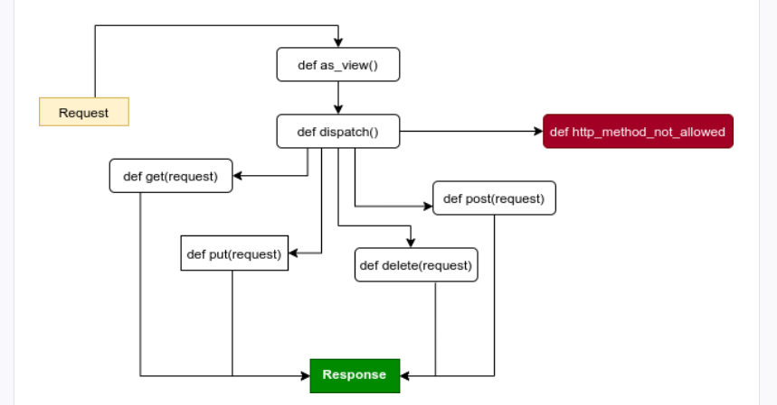
Class bases views flowchart

Slide 9
List View
https://docs.djangoproject.com/en/4.2/topics/class-based-views/intro/
https://docs.djangoproject.com/en/4.2/ref/class-based-views/generic-display/#django.views.generic.list.ListView
https://docs.djangoproject.com/en/4.2/ref/class-based-views/mixins-multiple-object/#django.views.generic.list.MultipleObjectMixin

Slide 10
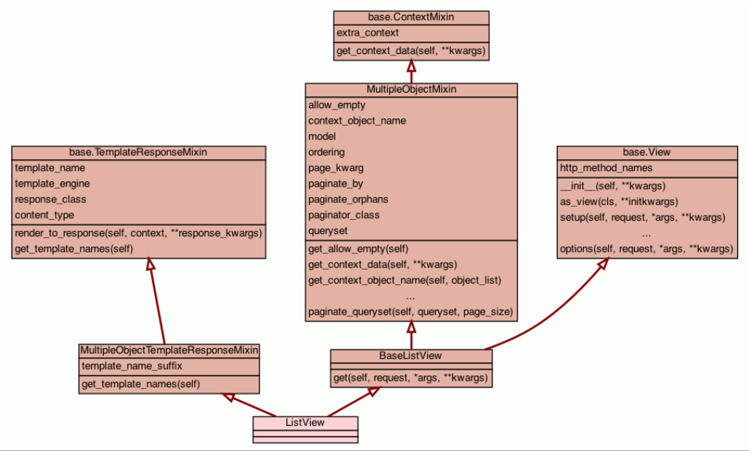

Slide 11
dETAIL vIEW
https://docs.djangoproject.com/en/4.2/ref/class-based-views/generic-display/#generic-display-views
https://docs.djangoproject.com/en/4.2/ref/class-based-views/mixins-single-object/#django.views.generic.detail.SingleObjectMixin

Slide 12
Form View
https://docs.djangoproject.com/en/4.2/ref/class-based-views/generic-editing/
https://docs.djangoproject.com/en/4.2/topics/class-based-views/generic-editing/

Slide 13
Create view
https://docs.djangoproject.com/en/4.2/ref/class-based-views/generic-editing/#django.views.generic.edit.CreateView

Slide 14
Update view
https://docs.djangoproject.com/en/4.2/ref/class-based-views/generic-editing/#django.views.generic.edit.UpdateView

Slide 15
Delete view
https://docs.djangoproject.com/en/4.2/ref/class-based-views/generic-editing/#django.views.generic.edit.DeleteView

Slide 16
Django contrib auth mixins

Slide 17
Login required mixin

